Slide 1
National Capital Region (NCR) EMPLOYMENT DEMAND

Slide 2



















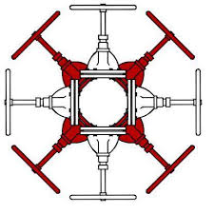





























The study sampled 100 companies with 133,129 projected job openings
Companies including:
Tourism
Manufacturing
Logistics
ICT
Health
Construction
Notes:
Companies were sector tagged based on the roles they were hiring for. Some companies were hiring for roles in different sectors. 3 companies were based outside of NCR, lowering the total demand estimate to 128,615.

Slide 3

Who do employers want to hire?
Majority of the jobs declared by employers only require basic skilling through existing training regulations
However, there is a significant growing number of jobs that require higher level competencies, and also jobs with emerging competency needs
Jobs by Qualification Levels
Job Openings (%) By Hiring Volume
Education Requirements
Level I-II NCs
E.g., BARTENDING NC II , CAREGIVING NC II
Basic/Entry Level
44,858
43%
Job requirements that look for national certificates for entry level roles
Levels III-IV
E.g., CAD/CAM OPERATION NCIII, EMERGENCY MEDICAL SERVICE NC III
Intermediate/Managerial
34,878
33%
Job requirements that look for national certificates with more advanced competencies, or for managerial roles
Unspecified
E.g., STERILE TECHNICIAN, DATA RECORDERS
26,443
24%
67% Entry Level Versus 33% Intermediate
IF unspecified jobs are labeled Level I-II
n=106,179
With Training Regulation
Jobs With Corresponding TRs
E.g., COOK, PLUMBER, MACHINE OPERATION, BARISTA, ELECTRICIAN
69,328
74%
Job requirements where TESDA has existing training regulations that match their needed competencies
New and Emerging
Jobs with New and Emerging Competencies
E.g., CLOUD COMPUTING, HEALTH COORDINATOR
24,338
26%
Job requirements where TESDA must develop new or update existing training regulations to address demand. Top sectors with these jobs are Tourism and Healthcare.
n=93,666
39, 413 excluded, blanks

Slide 4
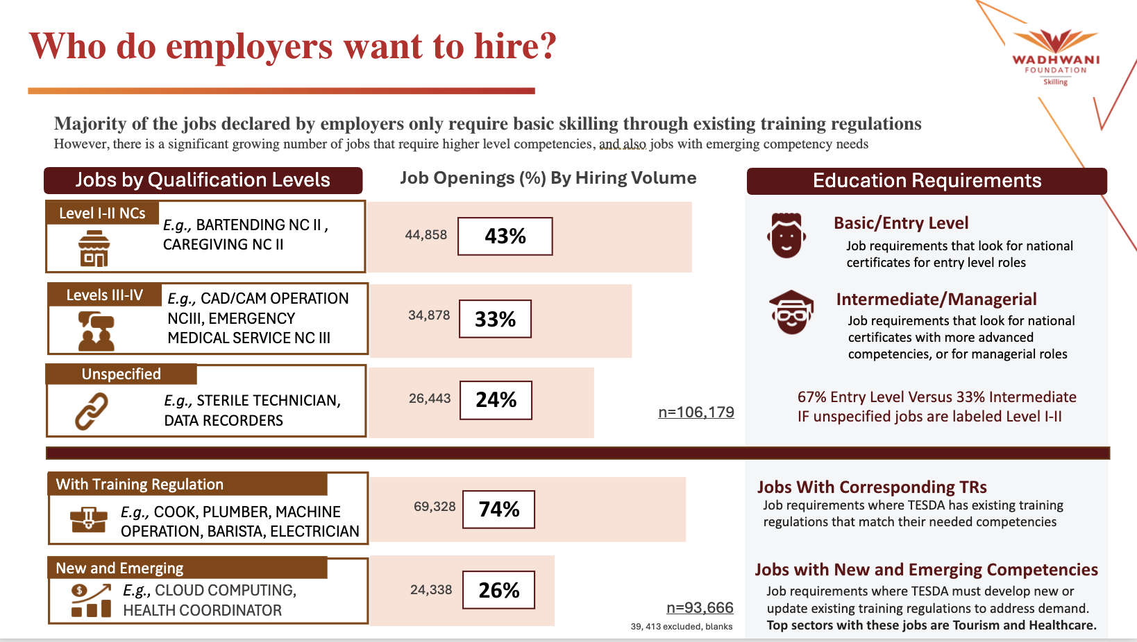
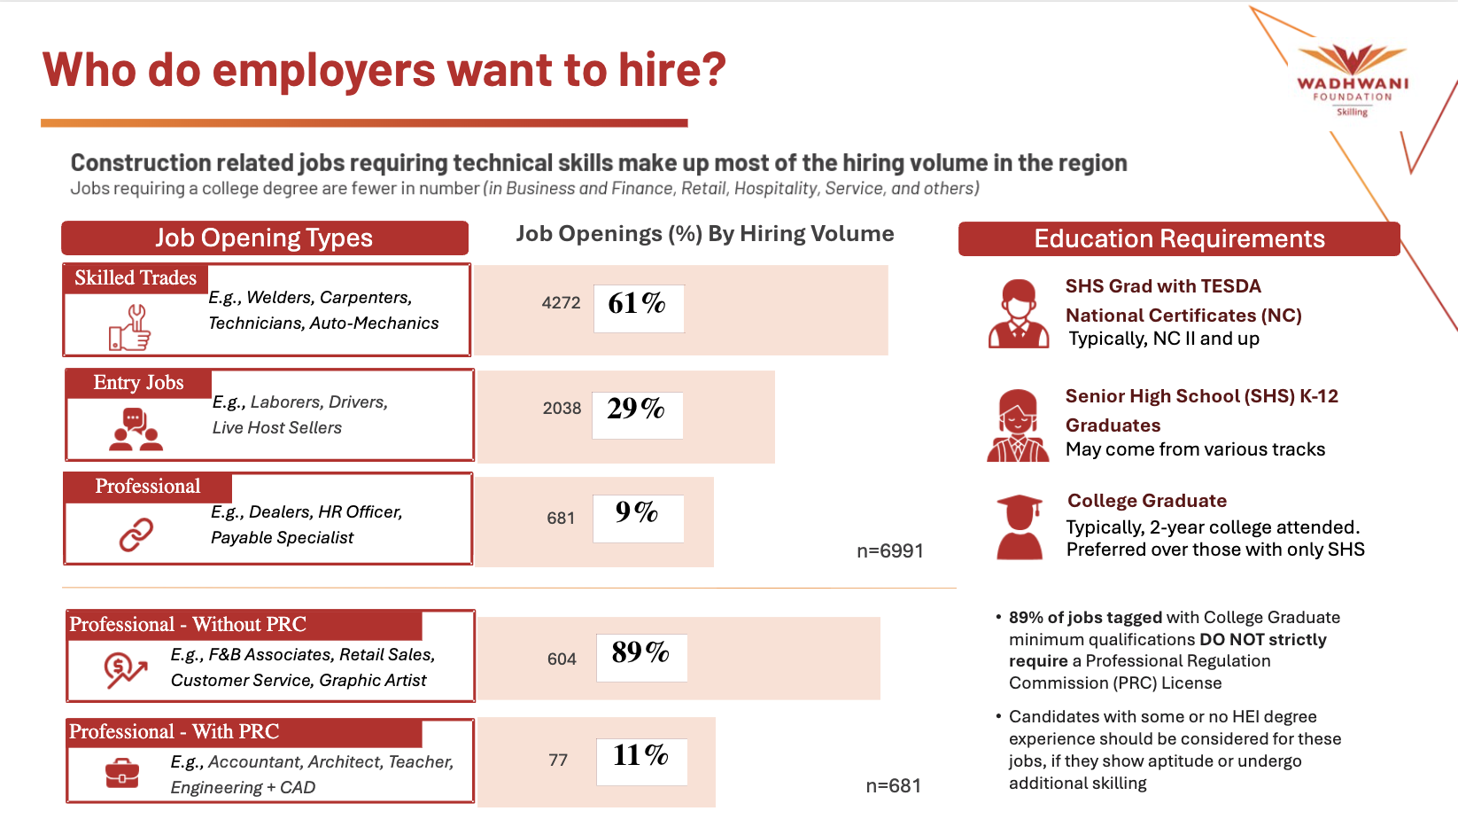
NCR ABDD VS CEBU CHAMBER

Slide 5
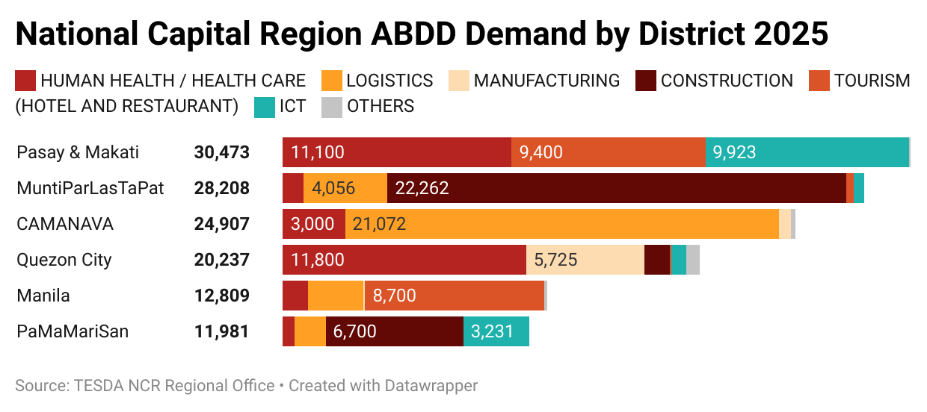
128,615 potential hiring in NCR from 97 companies, mainly in Pasay & Makati, MuntiParLasTapaT, and CAMANAVA
Key Insights
Across all districts the top sectors based on hiring volume are:
1. Construction (30,253)
2. Logistics (29,308) 3. Tourism (18,500)
4. ICT (14,435)
5. Manufacturing (6,330)
6. Others (1,079)
n=128,615
4,514 excluded, not in NCR

Slide 6
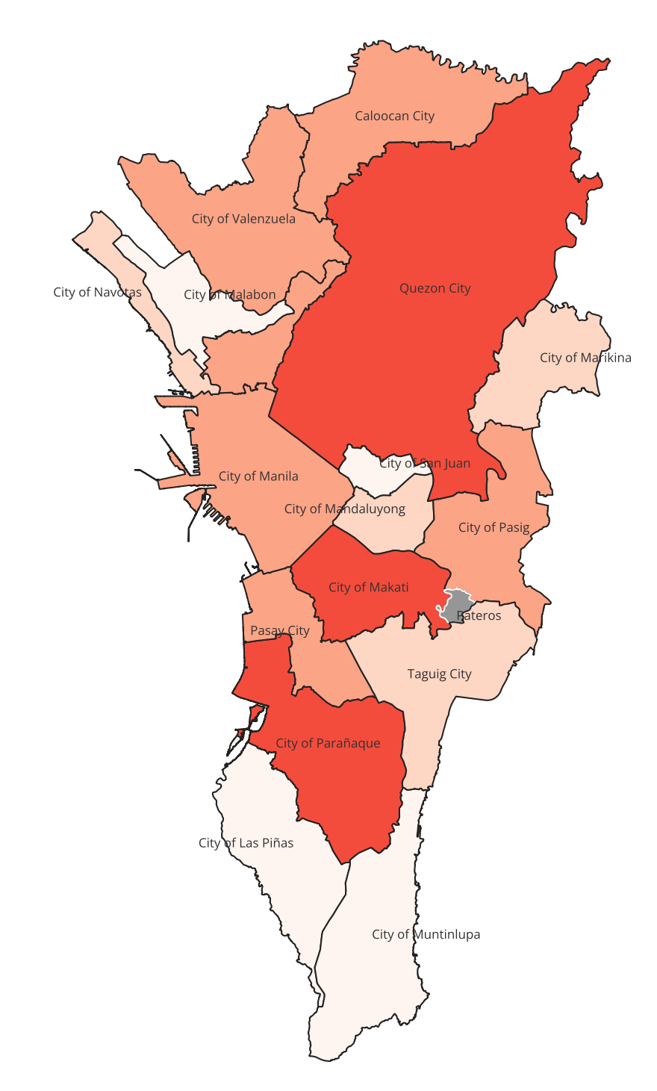
Where is the hiring taking place?
Top 3 Municipalities in NCR
Companies Are Hiring From
City of Makati (24,773)
Sectors: IT, Healthcare
Jobs: Data Analyst, Data Scientist, Advanced Pre-Hospital Care, Critical Care Paramedic, Customer Care Representative
City of Parañaque (22,148)
Sectors: Construction, Logistics
Jobs: Line Worker, Mason, Plumber, Automotive Maintenance, Cargo, Delivery
Quezon City (20,237)
Sectors: Healthcare (Wellness), Manufacturing
Jobs: Aesthetician, Skin Care Specialist, Eyelash and Eyebrow & Nail Technicians, Food Processing Trade Workers
Legend | Hiring Sum
Highest | 20,000 - 25,000
High | 5,000-20,000
Medium | 1,000-5,000
Low | 100-1,000
None | 0, (Pateros)
From Phase 1B data, Hiring Sum derived from both indicated values by companies that gave exact hiring numbers, and estimated values from companies that answered hiring ranges: low (50), medium (250), and high (500)

Slide 7
TALENT SUPPLY

Slide 8
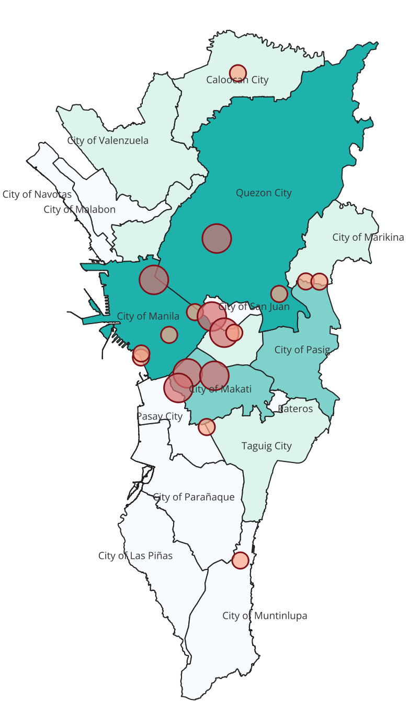

109,612 TVET graduates in 2024 spread out over 353 institutes
More than half of all TVET institutions in NCR are small-scale, with 70% producing fewer than the average of 310 graduates each.
Key Insights
3 out of 10 schools (30%) have more than the average number of graduates (310), holding between >310 – 3191 graduates
Only 5.9% of schools produce over 1,000 graduates, found in Quezon City, Manila City, and Makati City
The median number of graduates per school are 165 students yearly
Legend | TVET Graduates | Graduates per Institute
Very High | 15,000-20,000 | 1500 - 3191
High | 10,000-15,000 | 1000 - 1500
Medium | 5,000-10,000 | 310 - 1000
Low | 0-5,000 | 0 - 310
TVET graduates per institute obtained from TESDA data, from TESDA-ICTO
Big Institutes in NCR
Smaller Institutes in NCR

Slide 9

Research outputs attributed to Wadhwani Skilling Network - PH

